Slide 1
SSZG518: Database design and Applications Ms. Uma Maheswari

Slide 2
Session 15
Application development and advanced SQL logic

Slide 3
LEARNING OUTCOME
Using databases in applications
Accessing databases from programming languages
Triggers
Stored procedures
REFER: T1-Chapter 12
Sections: 12.1- 12

Slide 4
Application development

Slide 5
Application development
Organizational Context for using Database Systems
Information System Life Cycle
Phases of Database Design
UML Diagrams
Rational Rose
Other tools
Design Tools
Consolidation and integration of data across organization
Maintenance of complex data
Simplicity of developing new applications
Data independence
Protecting application programs from changes in the underlying logical organization and in the physical access paths and storage structures
External Schemas
Allow the same data to be used for multiple applications with each application having its own view of the data

Slide 6
Information System
Information System includes all resources involved in the collection, management, use and dissemination of the information resources of the organization
We consider two systems life cycles:
Macro Life Cycle
Information System Life Cycle
Micro Life Cycle
Database System Life Cycle

Slide 7
Phases of Information System Life Cycle
Feasibility Analysis
Analyzing potential application areas
Identifying the economics of information gathering and dissemination
Performing cost benefit studies
Setting up priorities among applications
Requirement Collection and Analysis
Detailed Requirements Collection
Interaction with Users
Design
Design of Database System
Design of programs that use and process the database

Slide 8
Phases of Information System Life Cycle (contd.)
Implementation
Information system is implemented
Database is loaded & its transactions are implemented and tested
Validation and Acceptance Testing
Testing against user’s requirements
Testing against performance criteria
Deployment, Operation and Maintenance
Data conversion
Training
System maintenance
Performance monitoring
Database tuning

Slide 9
Database System Life Cycle
System definition
Defining scope of database system, its users and applications
Database Design
Logical and physical design of the database system on the chosen DBMS
Database implementation
Specifying conceptual, external and internal database definitions
Creating empty database files
Implementing software applications

Slide 10
Database System Life Cycle (contd.)
Loading or data conversion
Populating the database
Application conversion
Converting applications to the new system
Testing and validation
Operation
Running the new system
Monitoring and maintenance
System maintenance
Performance monitoring

Slide 11
Database Design Process
Problem
Design the logical and physical structure of one or more databases to accommodate the information needs of the users in an organization for a defined set of applications.
Goals
Satisfy the content requirements
Provide easy structuring of information
Support processing requirements and performance objectives

Slide 12
Phases of Database Design and Implementation Process
Requirements Collections and Analysis
Conceptual Database Design
Choice of a DBMS
Data Model Mapping (Logical Database Design)
Physical Database Design
Database System Implementation and Tuning

Slide 13
Phases of Database Design and Implementation Process (contd.)
Requirements Collections and Analysis
Identifying Users
Interacting with users to gather requirements
Time consuming BUT very important
Very expensive to fix requirements error
Conceptual Database Design
Produce a conceptual schema for the database that is independent of a specific DBMS
Involves two parallel activities
Conceptual Schema Design
Transaction and Application Design

Slide 14
Conceptual Schema Design
Goal
Complete understanding of the database structure, semantics, interrelationships and constraints
Serves as a stable description of the database contents
Good understanding crucial for the users and designers
Diagrammatic description serves as an excellent communication tool

Slide 15
Desired Characteristics of Conceptual Data Model
Expressiveness
Able to distinguish different types of data, relationships and constraints
Simplicity and Understandability
Easy to understand
Minimality
Small number of distinct basic concepts
Diagrammatic Representation
Diagrammatic notation for representing conceptual schema
Formality
Formal unambiguous specification of data

Slide 16
Approaches to Conceptual Schema Design
Centralized Schema Design Approach
Also known as one-shot approach
Requirements of different applications and user groups are merged into a single set of requirements and a single schema is designed
Time consuming, places the burden on DBA to reconcile conflicts
View Integration Approach
Schema is designed for each user group or application
These schemas are then merged into a global conceptual schema during the view integration phase
More practical

Slide 17
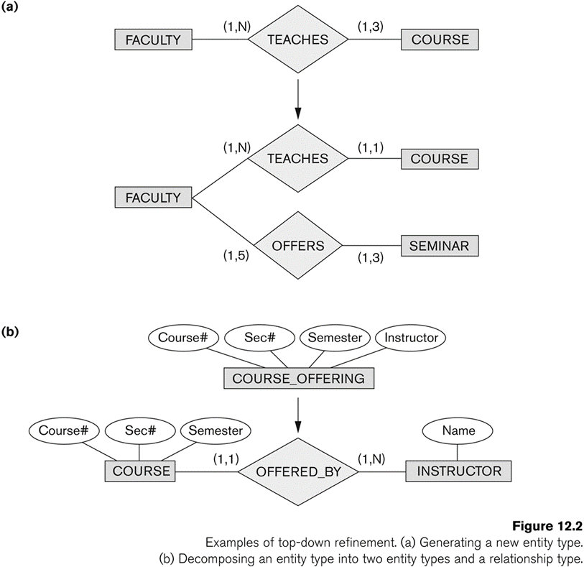
Strategies for Schema Design
Top Down Strategy
Start with a schema containing high-level abstractions and then apply successive top-down refinements

Slide 18
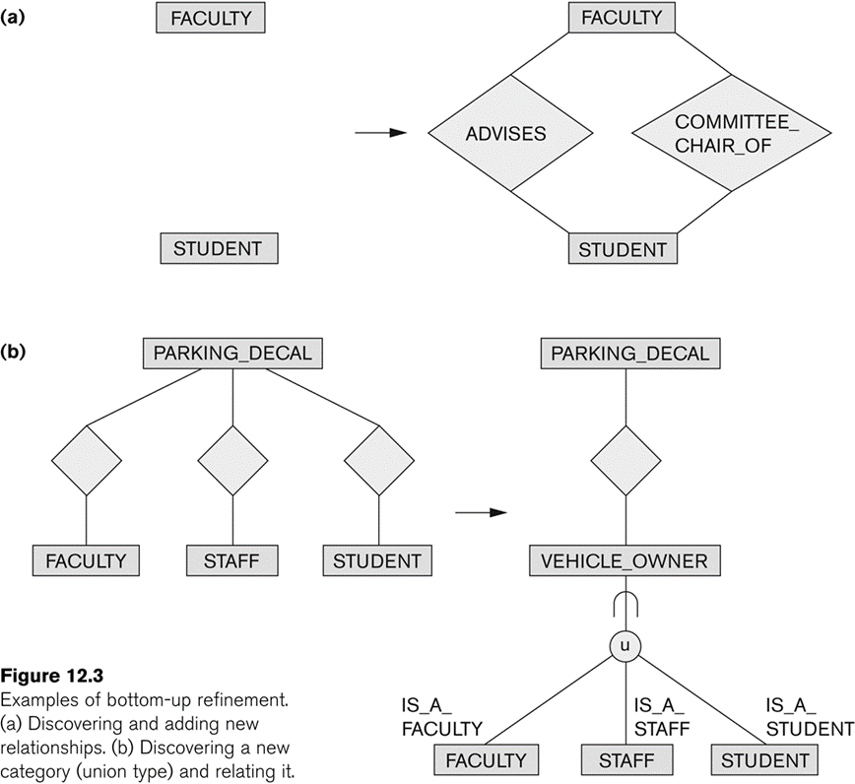
Strategies for Schema Design (contd.)
Bottom-Up Strategy
Start with a schema containing basics abstractions and then combine or add to these abstractions

Slide 19
Strategies for Schema Design (contd.)
Inside-out Strategy
Start with central set of concepts and then spread outward by considering new concepts in the vicinity of existing ones
Mixed Strategy
Use a combination of top-down and bottom-up strategies

Slide 20
Schema Integration
Identifying correspondence and conflict among different schemas
Naming conflicts
Synonyms: The same concept but different names
e.g. entity types CUSTOMER and CLIENT
Homonyms: Different concepts but same name
e.g. entity type PART as computer parts and furniture parts
Type Conflicts: Representing the same concept by different modeling constructs
e.g. DEPARTMENT may be an entity type and an attribute
Domain Conflicts: Attribute has different domains
Also known as value set conflicts
e.g. SSN as an integer and as a character string
Conflict among constraints: Two schemas impose different constraints
e.g. different key of an entity type in different schemas

Slide 21
Schema Integration (contd.)
Modifying views to conform to one another
Modifying schemas to conform to one another
Merging of views
Merging Schemas to create a global schema
Specifying mappings between views and global schema
Time consuming and difficult
Restructuring
Simplifying and restructuring to remove any redundancies

Slide 22
View Integration Strategies
Binary Ladder Integration
Two similar schemas are integrated first and the resulting schema is then integrated with another schema
The process is repeated until all schemas are integrated
N-ary Integration
All views are integrated in one procedure after analysis and specification of their correspondences
Requires computerized tools for large designs

Slide 23
View Integration Strategies (contd.)
Binary Balanced Strategy
Pairs of schemas are integrated first and the resulting schemas are then paired for further integration.
This process is repeated until a final global schema
Mixed Strategy
Schemas are partitioned into groups based on their similarity and each group is integrated separately.
This process is repeated until a final global schema

Slide 24
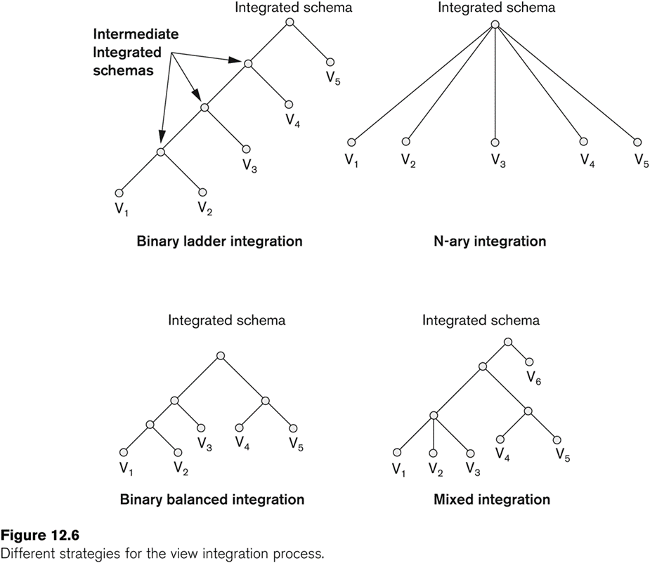
View Integration Strategies (contd.)

Slide 25
Transaction Design
Design characteristics of known database transactions in a DBMS
Types of Transactions
Retrieval Transactions
Used to retrieve data
Update Transactions
Update data
Mixed Transactions
Combination of update and retrieval
Techniques for Specifying Transactions
Input/output
Functional Behavior

Slide 26
Choice of DBMS
Many factors to consider
Technical Factors
Type of DBMS: Relational, object-relational, object etc.
Storage Structures
Architectural options
Economic Factors
Acquisition, maintenance, training and operating costs
Database creation and conversion cost
Organizational Factors
Organizational philosophy
Relational or Object Oriented
Vendor Preference
Familiarity of staff with the system
Availability of vendor services

Slide 27
Logical Database Design
Transform the Schema from high-level data model into the data model of the selected DBMS.
Design of external schemas for specific applications
Two stages
System-independent mapping
DBMS independent mapping
Tailoring the schemas to a specific DBMS
Adjusting the schemas obtained in step 1 to conform to the specific implementation features of the data model used in the selected DBMS
Result
DDL statements in the language of the chosen DBMS

Slide 28
Physical Database Design
Design the specifications for the stored database in terms of physical storage structures, record placements and indexes.
Design Criteria
Response Time
Elapsed Time between submitting a database transaction for execution and receiving a response
Space Utilization
Storage space used by database files and their access path structures
Transaction throughput
Average number of transactions/minute
Must be measured under peak conditions
Result
Initial determination of storage structures and access paths for database files

Slide 29
Database System Implementation and Tuning
During this phase database and application programs are implemented, tested and deployed
Database Tuning
System and Performance Monitoring
Data indexing
Reorganization
Tuning is a continuous process

Slide 30
UML Diagrams
Class Diagrams
Capture the static structure of the system
Represent classes, Interfaces, dependencies, generalizations and other relationships
Object Diagrams
Show a set of objects and their relationships
Component Diagrams
Show the organizations and dependencies among software components
Deployment Diagrams
Represent the distribution of components across the hardware topology

Slide 31
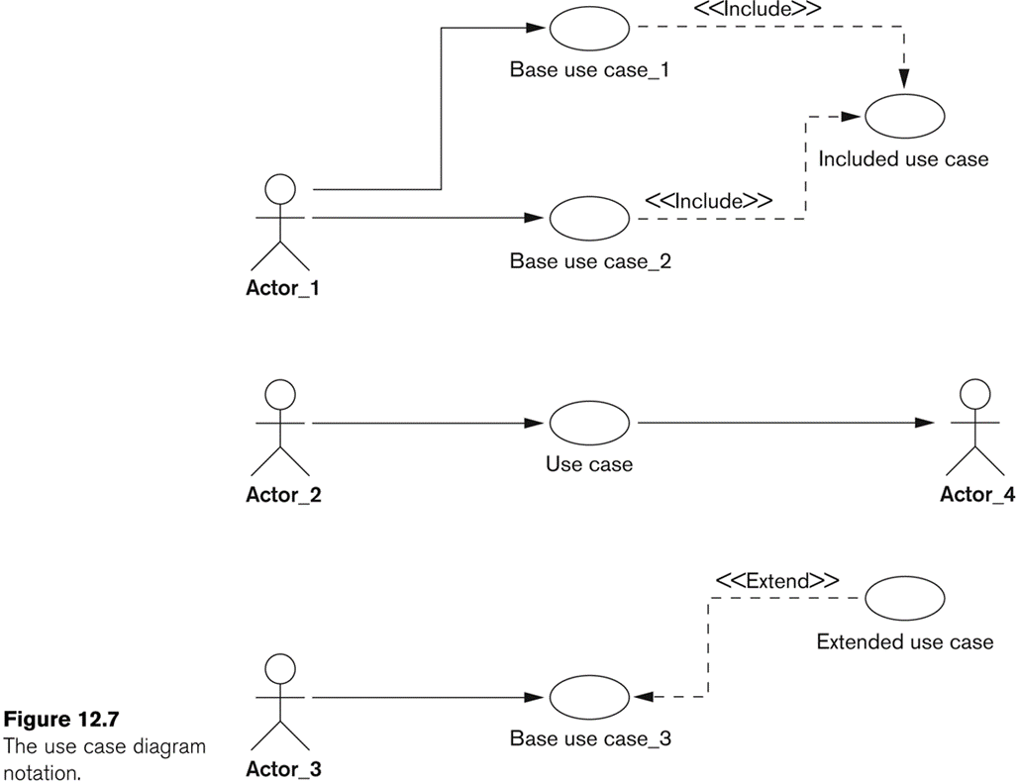
UML Diagrams (contd.)
Use Case Diagrams
Model the functional interactions between users and system
Describe scenarios of use
Serve as a communication tool between users and developers

Slide 32
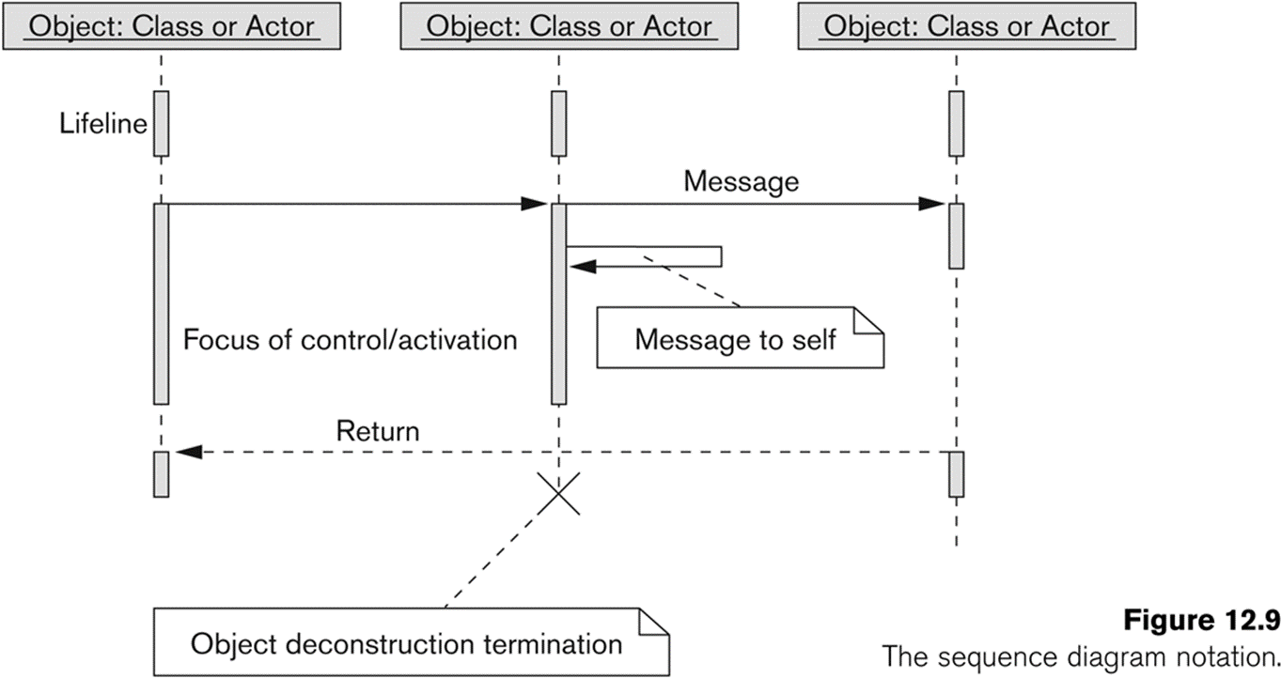
UML Diagrams (contd.)
Sequence Diagrams
Represent interactions between various objects over time
Relate uses cases and class diagrams

Slide 33
UML Diagrams (contd.)
Collaboration Diagrams
Represent interactions between objects as a series of sequenced messages
Statechart Diagram
Describe how an object’s state changes in response to external events
Consist of states, transitions, actions, activities and events

Slide 34
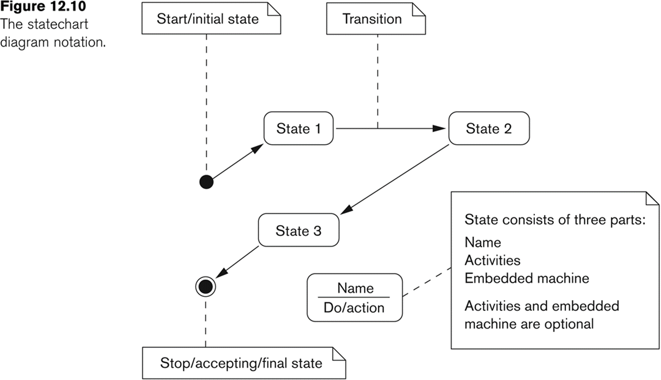
UML Diagrams (contd.)

Slide 35
UML Diagrams (contd.)
Activity Diagrams
Model the flow of control from activity to activity
Flowcharts with states

Slide 36
Salient Features of Rational Rose Data Modeler
UML based modeling tool for designing databases
Reverse Engineering
Generate a conceptual data model from an existing DBMS database or DDL
Forward Engineering
Create application/data model
Generate DDL from data model

Slide 37
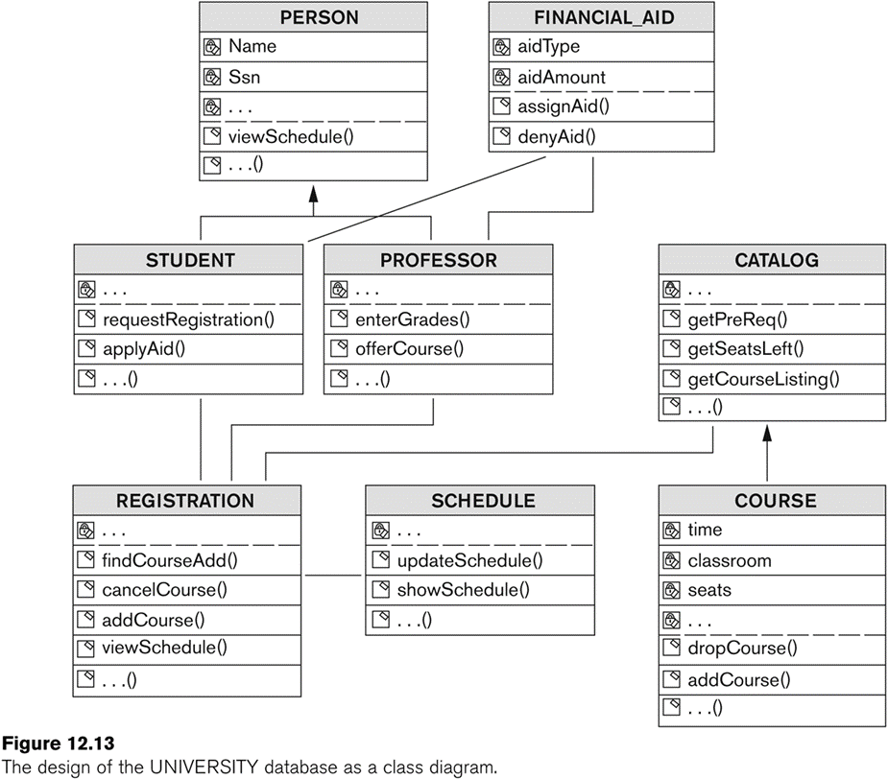
Salient Features of Rational Rose Data Modeler (contd.)

Slide 38
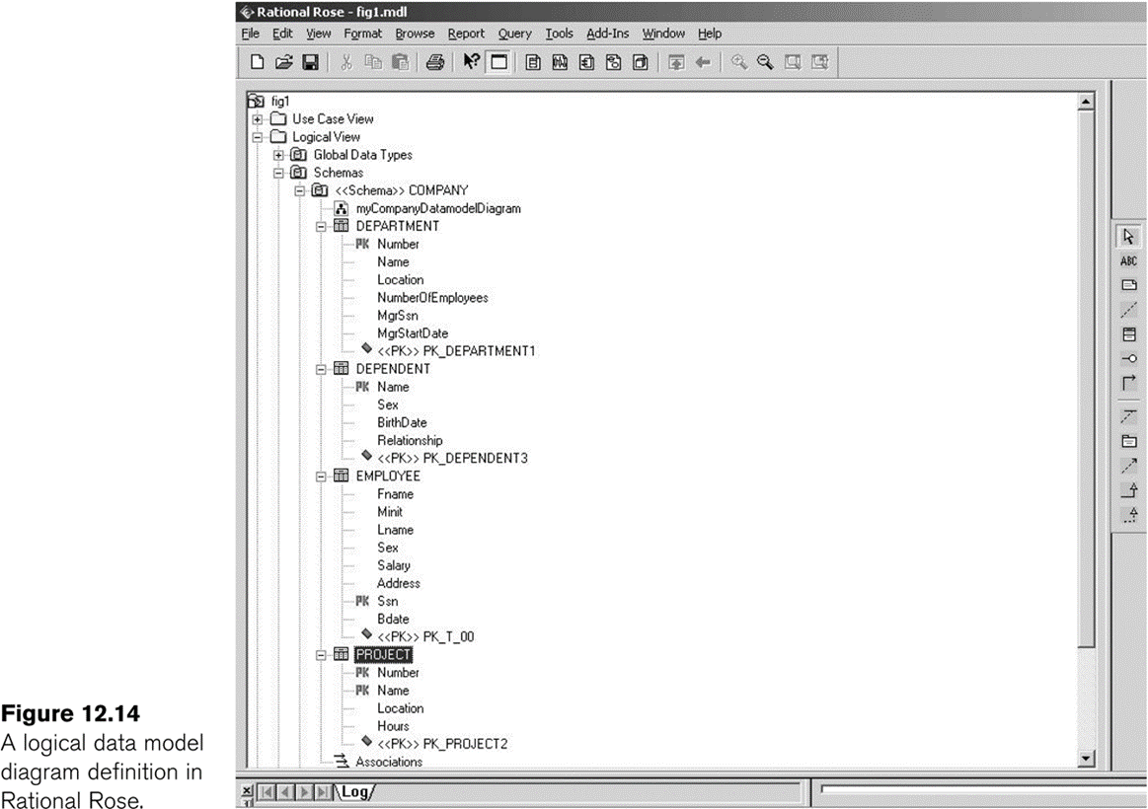
Salient Features of Rational Rose Data Modeler (contd.)
Modeling ER diagrams in UML
ER schema from the company example in chapter 3 can be drawn in Rational Rose using UML notation

Slide 39
Salient Features of Rational Rose Data Modeler (contd.)
Keeps the data model and database synchronized
Gives the option of updating the model or changing the database
Provides Extensive Domain Support
Allows database designers to create a standard set of user-defined types
Allows Converting between logical and object model design
Allows easy communication between various developing and design teams
Provides a common tool and platform to designers and developers
Rational Rose Web Publisher

Slide 40
Database Design Tools
Common Features
Allow the designer to draw conceptual schema diagram in some tool-specific notation
Allow model mapping
Allow some level of design normalization
Problems
Most tools do nothing more than representing relationships among tables
Most tools lack built-in methodology support
Most tools have poor design verification system

Slide 41
Characteristics of a Good Design Tool
Easy-to-use interface
Easy to use
Customizable
Analytical components
For difficult tasks
such as evaluating physical design alternatives or detecting conflicting constraints among views
Heuristic components
Automating design process using heuristic rules

Slide 42
Characteristics of a Good Design Tool (contd.)
Trade-off analysis
Comparative analysis in case of multiple alternatives
At least at the conceptual design level
Display of design results
Displaying results in simple and easy to understand form
Design Verification
Verifying that the resulting design satisfies the initial requirements

Slide 43
Advanced SQL

Slide 44
General Constraints as Assertions
Views in SQL
Database Programming
Embedded SQL\
Functions Calls, SQL/CLI
Stored Procedures, SQL/PSM

Slide 45
Constraints as Assertions
Specification of more general constraints via assertions
SQL facilities for defining views (virtual tables)
Various techniques for accessing and manipulating a database via programs in general-purpose languages
E.g., Java, C++, etc.
General constraints: constraints that do not fit in the basic SQL categories (presented in chapter 8)
Mechanism: CREAT ASSERTION
Components include:
a constraint name,
followed by CHECK,
followed by a condition

Slide 46
Assertions: An Example

Slide 47
Using General Assertions
Specify a query that violates the condition; include inside a NOT EXISTS clause
Query result must be empty
if the query result is not empty, the assertion has been violated

Slide 48
TRIGGERS

Slide 49
SQL Triggers
Objective: to monitor a database and take initiate action when a condition occurs
Triggers are expressed in a syntax similar to assertions and include the following:
Event
Such as an insert, deleted, or update operation
Condition
Action
To be taken when the condition is satisfied

Slide 50
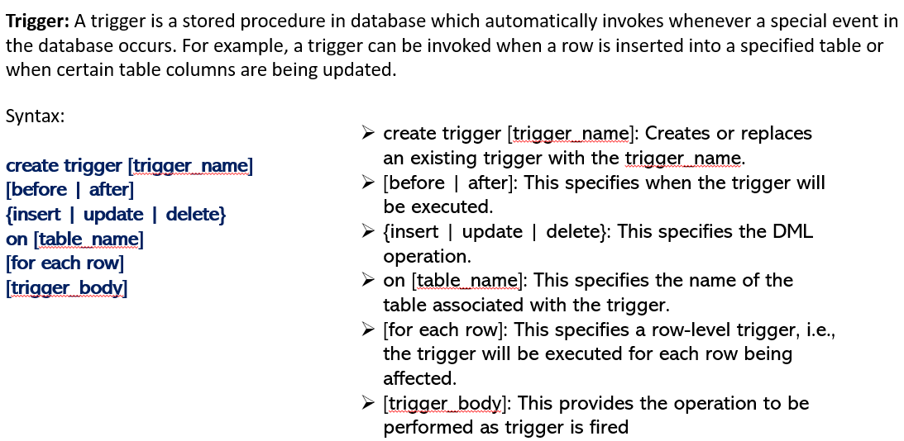
SQL Triggers

Slide 51
SQL Triggers

Slide 52
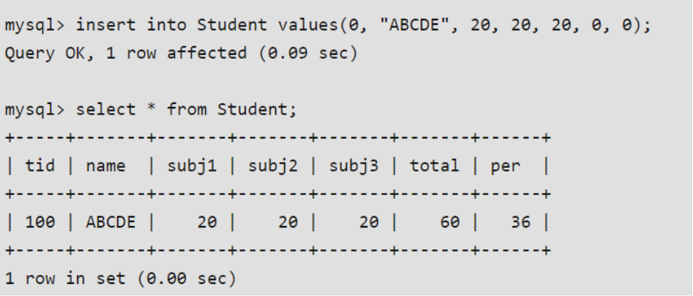
SQL Triggers
Above SQL statement will create a trigger in the student database in which whenever subjects marks are entered, before inserting this data into the database, trigger will compute those two values and insert with the entered values. i.e.,

Slide 53
SQL Triggers: An Example
A trigger to compare an employee’s salary to his/her supervisor during insert or update operations:
CREATE TRIGGER INFORM_SUPERVISOR
BEFORE INSERT OR UPDATE OF
SALARY, SUPERVISOR_SSN ON EMPLOYEE
FOR EACH ROW
WHEN
(NEW.SALARY> (SELECT SALARY FROM EMPLOYEE
WHERE SSN=NEW.SUPERVISOR_SSN))
INFORM_SUPERVISOR (NEW.SUPERVISOR_SSN,NEW.SSN);

Slide 54
Views in SQL
A view is a “virtual” table that is derived from other tables
Allows for limited update operations
Since the table may not physically be stored
Allows full query operations
A convenience for expressing certain operations

Slide 55
VIEWS

Slide 56
Specification of Views
SQL command: CREATE VIEW
a table (view) name
a possible list of attribute names (for example, when arithmetic operations are specified or when we want the names to be different from the attributes in the base relations)
a query to specify the table contents

Slide 57
SQL Views: An Example
Specify a different WORKS_ON table
CREATE VIEW WORKS_ON_NEW AS
SELECT FNAME, LNAME, PNAME, HOURS
FROM EMPLOYEE, PROJECT, WORKS_ON
WHERE SSN=ESSN AND PNO=PNUMBER
GROUP BY PNAME;

Slide 58
Using a Virtual Table
We can specify SQL queries on a newly create table (view):
SELECT FNAME, LNAME
FROM WORKS_ON_NEW
WHERE PNAME=‘Seena’;
When no longer needed, a view can be dropped:
DROP WORKS_ON_NEW;

Slide 59
Efficient View Implementation
Query modification:
Present the view query in terms of a query on the underlying base tables
Disadvantage:
Inefficient for views defined via complex queries
Especially if additional queries are to be applied to the view within a short time period

Slide 60
Efficient View Implementation
View materialization:
Involves physically creating and keeping a temporary table
Assumption:
Other queries on the view will follow
Concerns:
Maintaining correspondence between the base table and the view when the base table is updated
Strategy:
Incremental update

Slide 61
Update Views
Update on a single view without aggregate operations:
Update may map to an update on the underlying base table
Views involving joins:
An update may map to an update on the underlying base relations
Not always possible

Slide 62
Un-updatable Views
Views defined using groups and aggregate functions are not updateable
Views defined on multiple tables using joins are generally not updateable
WITH CHECK OPTION: must be added to the definition of a view if the view is to be updated
To allow check for updatability and to plan for an execution strategy

Slide 63
DATABASE Programming

Slide 64
Database Programming
Objective:
To access a database from an application program (as opposed to interactive interfaces)
Why?
An interactive interface is convenient but not sufficient
A majority of database operations are made thru application programs (increasingly thru web applications)

Slide 65
ODBC and JDBC

Slide 66
Database Programming Approaches
Embedded commands:
Database commands are embedded in a general-purpose programming language
Library of database functions:
Available to the host language for database calls; known as an API
API standards for Application Program Interface
A brand new, full-fledged language
Minimizes impedance mismatch

Slide 67
Impedance Mismatch
Incompatibilities between a host programming language and the database model, e.g.,
type mismatch and incompatibilities; requires a new binding for each language
set vs. record-at-a-time processing
need special iterators to loop over query results and manipulate individual values

Slide 68
Steps in Database Programming
Client program opens a connection to the database server
Client program submits queries to and/or updates the database
When database access is no longer needed, client program closes (terminates) the connection

Slide 69
Embedded SQL
Most SQL statements can be embedded in a general-purpose host programming language such as COBOL, C, Java
An embedded SQL statement is distinguished from the host language statements by enclosing it between EXEC SQL or EXEC SQL BEGIN and a matching END-EXEC or EXEC SQL END (or semicolon)
Syntax may vary with language
Shared variables (used in both languages) usually prefixed with a colon (:) in SQL

Slide 70
Example: Variable Declaration in Language C
Variables inside DECLARE are shared and can appear (while prefixed by a colon) in SQL statements
SQLCODE is used to communicate errors/exceptions between the database and the program
int loop;
EXEC SQL BEGIN DECLARE SECTION;
varchar dname[16], fname[16], …;
char ssn[10], bdate[11], …;
int dno, dnumber, SQLCODE, …;
EXEC SQL END DECLARE SECTION;

Slide 71
SQL Commands for Connecting to a Database
Connection (multiple connections are possible but only one is active)
CONNECT TO server-name AS connection-name
AUTHORIZATION user-account-info;
Change from an active connection to another one
SET CONNECTION connection-name;
Disconnection
DISCONNECT connection-name;

Slide 72
Embedded SQL in C Programming Examples
loop = 1;
while (loop) {
prompt (“Enter SSN: “, ssn);
EXEC SQL
select FNAME, LNAME, ADDRESS, SALARY
into :fname, :lname, :address, :salary
from EMPLOYEE where SSN == :ssn;
if (SQLCODE == 0) printf(fname, …);
else printf(“SSN does not exist: “, ssn);
prompt(“More SSN? (1=yes, 0=no): “, loop);
END-EXEC
}

Slide 73
Embedded SQL in C Programming Examples
A cursor (iterator) is needed to process multiple tuples
FETCH commands move the cursor to the next tuple
CLOSE CURSOR indicates that the processing of query results has been completed

Slide 74
Dynamic SQL
Objective:
Composing and executing new (not previously compiled) SQL statements at run-time
a program accepts SQL statements from the keyboard at run-time
a point-and-click operation translates to certain SQL query
Dynamic update is relatively simple; dynamic query can be complex
because the type and number of retrieved attributes are unknown at compile time

Slide 75
Dynamic SQL: An Example
EXEC SQL BEGIN DECLARE SECTION;
varchar sqlupdatestring[256];
EXEC SQL END DECLARE SECTION;
…
prompt (“Enter update command:“, sqlupdatestring);
EXEC SQL PREPARE sqlcommand FROM :sqlupdatestring;
EXEC SQL EXECUTE sqlcommand;

Slide 76
Embedded SQL in Java
SQLJ: a standard for embedding SQL in Java
An SQLJ translator converts SQL statements into Java
These are executed thru the JDBC interface
Certain classes have to be imported
E.g., java.sql

Slide 77
Java Database Connectivity
JDBC:
SQL connection function calls for Java programming
A Java program with JDBC functions can access any relational DBMS that has a JDBC driver
JDBC allows a program to connect to several databases (known as data sources)

Slide 78
Steps in JDBC Database Access
Import JDBC library (java.sql.*)
Load JDBC driver: Class.forname(“oracle.jdbc.driver.OracleDriver”)
Define appropriate variables
Create a connect object (via getConnection)
Create a statement object from the Statement class:
1. PreparedStatment 2. CallableStatement
Identify statement parameters (designated by question marks)
Bound parameters to program variables
Execute SQL statement (referenced by an object) via JDBC’s executeQuery
Process query results (returned in an object of type ResultSet)
ResultSet is a 2-dimentional table

Slide 79
Embedded SQL in Java: An Example
ssn = readEntry("Enter a SSN: ");
try {
#sql{select FNAME< LNAME, ADDRESS, SALARY
into :fname, :lname, :address, :salary
from EMPLOYEE where SSN = :ssn};
}
catch (SQLException se) {
System.out.println("SSN does not exist: ",+ssn);
return;
}
System.out.println(fname + " " + lname + … );

Slide 80
Multiple Tuples in SQLJ
SQLJ supports two types of iterators:
named iterator: associated with a query result
positional iterator: lists only attribute types in a query result
A FETCH operation retrieves the next tuple in a query result:
fetch iterator-variable into program-variable

Slide 81
Database Programming with Functional Calls
Embedded SQL provides static database programming
API: Dynamic database programming with a library of functions
Advantage:
No preprocessor needed (thus more flexible)
Disadvantage:
SQL syntax checks to be done at run-time

Slide 82
SQL Call Level Interface
A part of the SQL standard
Provides easy access to several databases within the same program
Certain libraries (e.g., sqlcli.h for C) have to be installed and available
SQL statements are dynamically created and passed as string parameters in the calls

Slide 83
Components of SQL/CLI
Environment record:
Keeps track of database connections
Connection record:
Keep tracks of info needed for a particular connection
Statement record:
Keeps track of info needed for one SQL statement
Description record:
Keeps track of tuples

Slide 84
Steps in C and SQL/CLI Programming
Load SQL/CLI libraries
Declare record handle variables for the above components (called: SQLHSTMT, SQLHDBC, SQLHENV, SQLHDEC)
Set up an environment record using SQLAllocHandle
Set up a connection record using SQLAllocHandle
Set up a statement record using SQLAllocHandle
Prepare a statement using SQL/CLI function SQLPrepare
Bound parameters to program variables
Execute SQL statement via SQLExecute
Bound query columns to a C variable via SQLBindCol
Use SQLFetch to retrieve column values into C variables

Slide 85
STORED PROCEDURES

Slide 86
Database Stored Procedures
Persistent procedures/functions (modules) are stored locally and executed by the database server
As opposed to execution by clients
Advantages:
If the procedure is needed by many applications, it can be invoked by any of them (thus reduce duplications)
Execution by the server reduces communication costs
Enhance the modeling power of views
Disadvantages:
Every DBMS has its own syntax and this can make the system less portable

Slide 87
Stored Procedure Constructs
A stored procedure
CREATE PROCEDURE procedure-name (params)
local-declarations
procedure-body;
A stored function
CREATE FUNCTION fun-name (params) RETRUNS return-type
local-declarations
function-body;
Calling a procedure or function
CALL procedure-name/fun-name (arguments);

Slide 88
SQL Persistent Stored Modules
SQL/PSM:
Part of the SQL standard for writing persistent stored modules
SQL + stored procedures/functions + additional programming constructs
E.g., branching and looping statements
Enhance the power of SQL

Slide 89
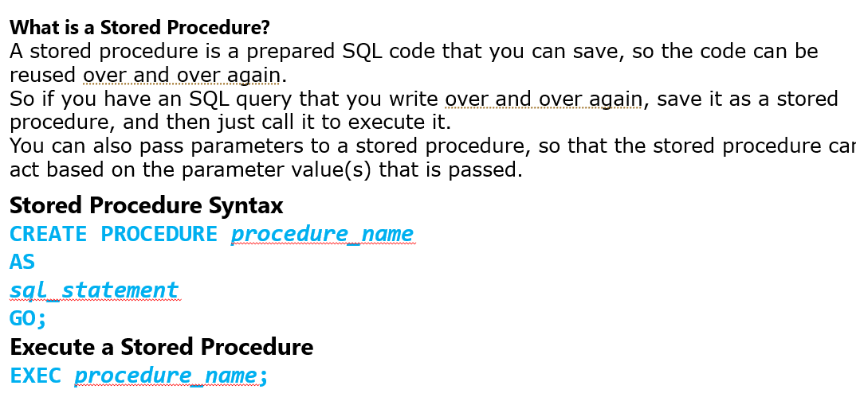
Database Stored Procedures

Slide 90
Database Stored Procedures
Stored Procedure With One Parameter
The following SQL statement creates a stored procedure that selects Customers from a particular City from the "Customers" table:
Example
CREATE PROCEDURE SelectAllCustomers @City nvarchar(30)
AS
SELECT * FROM Customers WHERE City = @City
GO;
Execute the stored procedure above as follows:
Example
EXEC SelectAllCustomers @City = "London";

Slide 91
Database Stored Procedures
Stored Procedure With Multiple Parameters
Setting up multiple parameters is very easy. Just list each parameter and the data type separated by a comma as shown below.
The following SQL statement creates a stored procedure that selects Customers from a particular City with a particular PostalCode from the "Customers" table:
Example
CREATE PROCEDURE SelectAllCustomers @City nvarchar(30), @PostalCode nvarchar(10)
AS
SELECT * FROM Customers WHERE City = @City AND PostalCode = @PostalCode
GO;
Execute the stored procedure above as follows:
Example
EXEC SelectAllCustomers @City = "London", @PostalCode = "WA1 1DP";

Slide 92
SQL/PSM: An Example
CREATE FUNCTION DEPT_SIZE (IN deptno INTEGER)
RETURNS VARCHAR[7]
DECLARE TOT_EMPS INTEGER;
SELECT COUNT (*) INTO TOT_EMPS
FROM SELECT EMPLOYEE WHERE DNO = deptno;
IF TOT_EMPS > 100 THEN RETURN “HUGE”
ELSEIF TOT_EMPS > 50 THEN RETURN “LARGE”
ELSEIF TOT_EMPS > 30 THEN RETURN “MEDIUM”
ELSE RETURN “SMALL”
ENDIF;

Slide 93
SAMPLE APPLICATION using PHP and MYSQL

Slide 94
Summary
Assertions provide a means to specify additional constraints
Triggers are assertions that define actions to be automatically taken when certain conditions occur
Views create temporary (virtual) tables
A database may be accessed in an interactive mode
Most often, however, data in a database is manipulate via application programs
Several methods of database programming:
Embedded SQL
Dynamic SQL
Stored procedure and function

Slide 95
THANKS.

